Slide 1
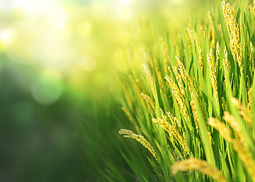
PLANT LEAF DISEASE DETECTION

Slide 2
PROBLEM STATEMENT:
One of the important sectors of Indian Economy is Agriculture. Employment to almost 50% of the countries workforce is provided by Indian agriculture sector. India is known to be the world's largest producer of pulses, rice, wheat, spices and spice products. Farmer's economic growth depends on the quality of the products that they produce, which relies on the plant's growth and the yield they get. Therefore, in field of agriculture, detection of disease in plants plays an instrumental role. Plants are highly prone to diseases that affect the growth of the plant which in turn affects the ecology of the farmer. In order to detect a plant disease at very initial stage, use of automatic disease detection technique is advantageous. The symptoms of plant diseases are conspicuous in different parts of a plant such as leaves, etc. Manual detection of plant disease using leaf images is a tedious job. Hence, it is required to develop computational methods which will make the process of disease detection and classification using leaf images automatic.

Slide 3
LITERATURE SURVEY:
In the paper ―Deep learning for Image-Based Plant detection” has proposed an approach to detect disease in plants by training a convolutional neural network.
The CNN model is trained to identify healthy and diseased plants of 14 species. The model achieved an accuracy of 99.35% on test set data. When using the model on images procured from trusted online sources, the model achieves an accuracy of 31.4%, while this is better than a simple model of random selection, a more diverse set of training data can aid to increase the accuracy.
Also some other variations of model or neural network training may yield higher accuracy, thus paving path for making plant disease detection easily available to everyone.
In the paper ―Detection and Classification of leaf disease using Artificial Neural Network” proposed an approach to detect diseases in plant utilizing the captured image of the diseased leaf. Artificial Neural Network (ANN) is trained by properly choosing feature values to distinguish diseased plants and healthy samples. The ANN model achieves an accuracy of 80%.

Slide 4
According to paper ―Detection of unhealthy region of plant leaves and classification of plant leaf diseases using texture features” disease identification process includes four main steps as follows: first, a color transformation structure is taken for the input RGB image, and then by means of a specific threshold value, the green pixels are detected and uninvolved, which is followed by segmentation process, and for obtaining beneficial segments the texture statistics are computed. At last, classifier is used for the features that are extracted to classify the disease.. Kulkarni et al. in the paper ―Applying image processing technique to detect plant diseases” a methodology for early and accurately plant diseases detection, using artificial neural network (ANN) and diverse image processing techniques. As the proposed approach is based on ANN classifier for classification and Gabor filter for feature extraction, it gives better results with a recognition rate of up to 91%.

Slide 5
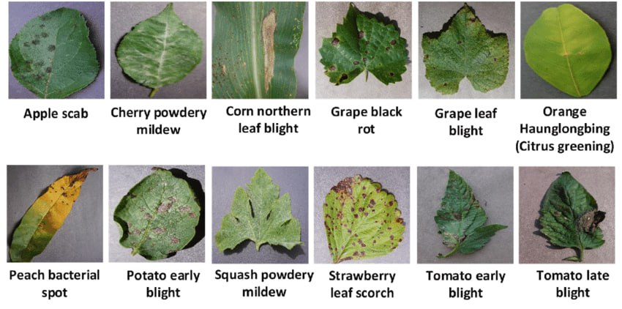
DATASET COLLECTION:
https://www.kaggle.com/datasets/vipoooool/new-plant-diseases-dataset

Slide 6
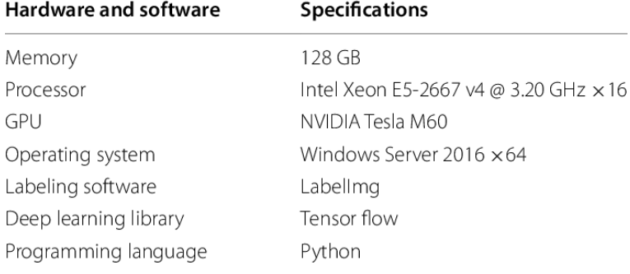
HARDWARE AND SOFTWARE REQUIREMENTS:

Slide 7
FUTURE WORK:
The analysis of the model is well suited for CNN machine learning classification technique with a desired accuracy compared to others. In future, the model can be improved using fusion techniques for extraction of significant features and examined for other leaf samples of datasets.

Slide 8

GITHUB SETUP:

Slide 9
TEAM MEMBERS:
M Likhitha Chowdary 2110030310 G Jahnavi Chowdary 2110030336
G. Sriya 2110030341
B. Shalini Reddy 2110030286
V Anurudh 2110030319

Slide 10

THANK YOU

